Slide 1
Voice Based Email
Under the guidance of
Mr. APPIREDDY V NAGIREDDY
(Assistant Professor, Department of CSE)
Team Number : 13
18BD1A058D
18BD1A058R
18BD1AO58V
18BD1A059H

Slide 2
OUTLINE
ABSTRACT
INTRODUCTION
SOFTWARE REQUIREMENTS SPECIFICATION
LITERATURE SURVEY
SYSTEM DESIGN
IMPLEMENTATION
REFERENCES

Slide 3
ABSTRACT
As the technology is enhancing, people are coming more closer to digital life and digital communication. There are many ways to communicate with others through internet in this new advanced era.
E-mail is the technology that enables user to contact with others by sending mails and also helps in business world communication.
The proposed idea is to create a web-based application using speech recognition, thus enabling everyone to control their mail accounts using their voice only and to be able to read, send, and perform all the other useful tasks like attachment of files.
The technology stack used is Python, HTML, CSS, JavaScript, MySQL database.

Slide 4
INTRODUCTION
Electronic mail (email) is a method of exchanging messages ("mail") between people using electronic devices.
This project aims to develop a voice based email system that would help people to access email in a hassle-free manner.
In the busy world sometimes, there would no proper time to clearly read emails. So, our project voice-based email uses text to speech.
To send long written emails faster a lot of typing is needed and keyboard practice, but the voice based system does it faster and makes it reliable.

Slide 5
INTRODUCTION
Existing System:
To send long written emails a lot of typing and keyboard practice is needed.
People often send emails of a regular format to many people and our system uses default templates to reduce the effort of the sender.
It’s time taking to read long emails, text to speech is not available.

Slide 6
INTRODUCTION
Proposed System:
The proposed system uses speech recognition, interactive voice response, and a click of the mouse.
The main benefit of this system is that the use of keyboard is completely eliminated, the user will have to respond through voice and mouse click only.
The three primary components of our system are: User validation, Speech recognition, Email services.
This system will be prompting the user to perform specific operations to avail email services like read, send emails.

Slide 7
SOFTWARE REQUIREMENTS SPECIFICATION
Functional Requirements:
New users must register in order to proceed further.
Users must log in to access the voice email system.
Users must enter the Gmail password.
The text-to-speech voice command should be realistic.
A microphone Button is available at each text input to change the text whenever needed.

Slide 8
SOFTWARE REQUIREMENTS SPECIFICATION
Non-Functional Requirements:
System use shall not cause any harm to human users.
System will use a secured database.
Every user is provided with a unique ID with their password.
Every user is authenticated before accessing their account.

Slide 9
SOFTWARE REQUIREMENTS SPECIFICATION
Software Requirements:
Operating System : Windows 10, Linux or MAC OS.
Programming Language : Python, JavaScript.
IDE : Visual Studio Code, Python.
Hardware Requirements:
Microphone : High-Definition audio device.
Internet : 1 Mbps or above.

Slide 10
LITERATURE SURVEY
SURVEY PAPER-1: “Voice Based Email for Blind People”, K. Jayachandran, P. Anbumani
DESCRIPTION: This paper contributes in such a way that enables people to send and receive voice-based email messages. It also consists of two main modules these are: (a) Speech-to-text converter (b) Text-to-speech converter
SURVEY PAPER-2: “Voice based e-mail System for Blinds”, Pranjal Ingle, Harshada Kanade, Arti Lanke
DESCRIPTION: In this paper, the proposed email system provides registration module firstly that helps in logging in by entering username and password.

Slide 11
LITERATURE SURVEY
Also, user’s voice gets recorded and stored in database. After this, the main app page shows the options of inbox and compose which is guided through IVR technology. There is contact us page where the user can suggest any suggestion.
SURVEY PAPER-3: “Speech Based E-mail System for Blind and Illiterate People”, Saurabh Sawant, Amankumar Wani, Sangharsh Sagar, Rucha Vanjari, M R Dhage
DESCRIPTION: In this paper, along with STT and TTS API, PHP Mailer is used for sending and fetching mails. For searching mails in inboxes, pattern matching algorithm is used. So, in this system Knuth Morris-Pratt algorithm is implemented.

Slide 12
Software Technologies
Flask:
Flask is a micro web framework written in Python.
It is classified as a microframework because it does not require particular tools or libraries.
It has no database abstraction layer, form validation, or any other components where pre-existing third-party libraries provide common functions.
However, Flask supports extensions that can add application features as if they were implemented in Flask itself.

Slide 13
Software Technologies
MySQL:
MySQL is an open-source relational database management system.
A relational database organizes data into one or more data tables in which data types may be related to each other; these relations help structure the data.
SQL is a language programmers use to create, modify and extract data from the relational database, as well as control user access to the database.
MySQL is used with other programs to implement applications that need relational database capability.

Slide 14
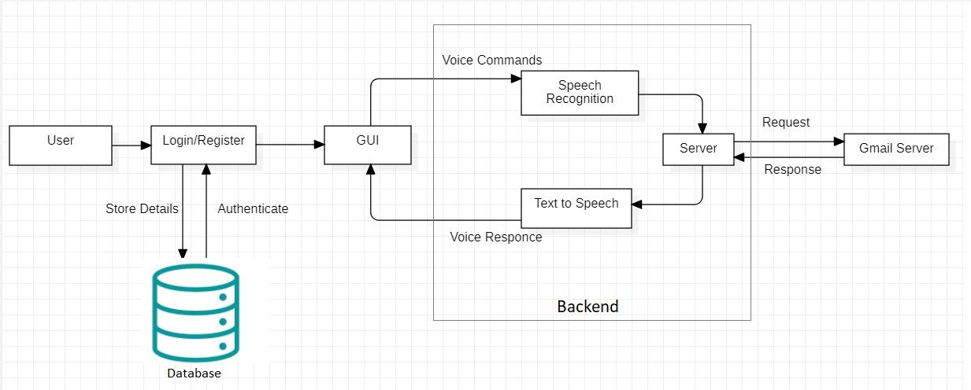
System Design
Architecture Design

Slide 15
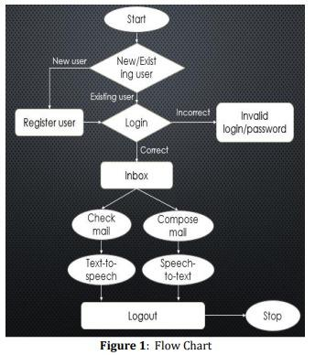
Flow Chart

Slide 16
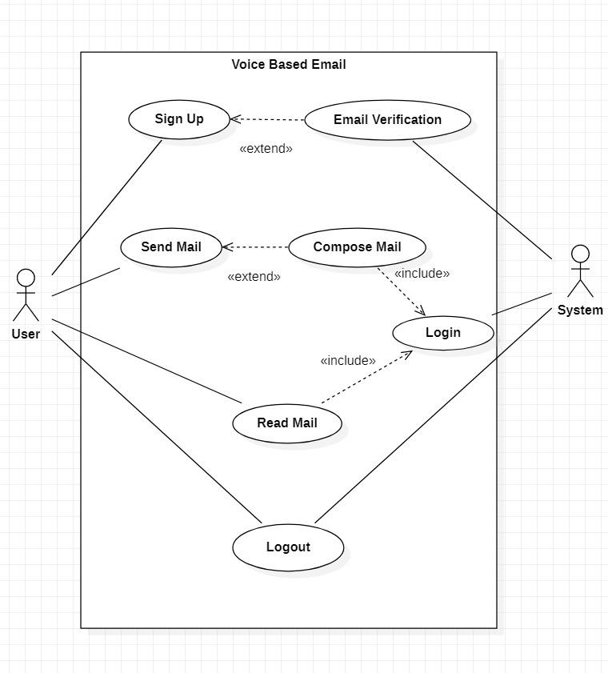
Use Case Diagram

Slide 17
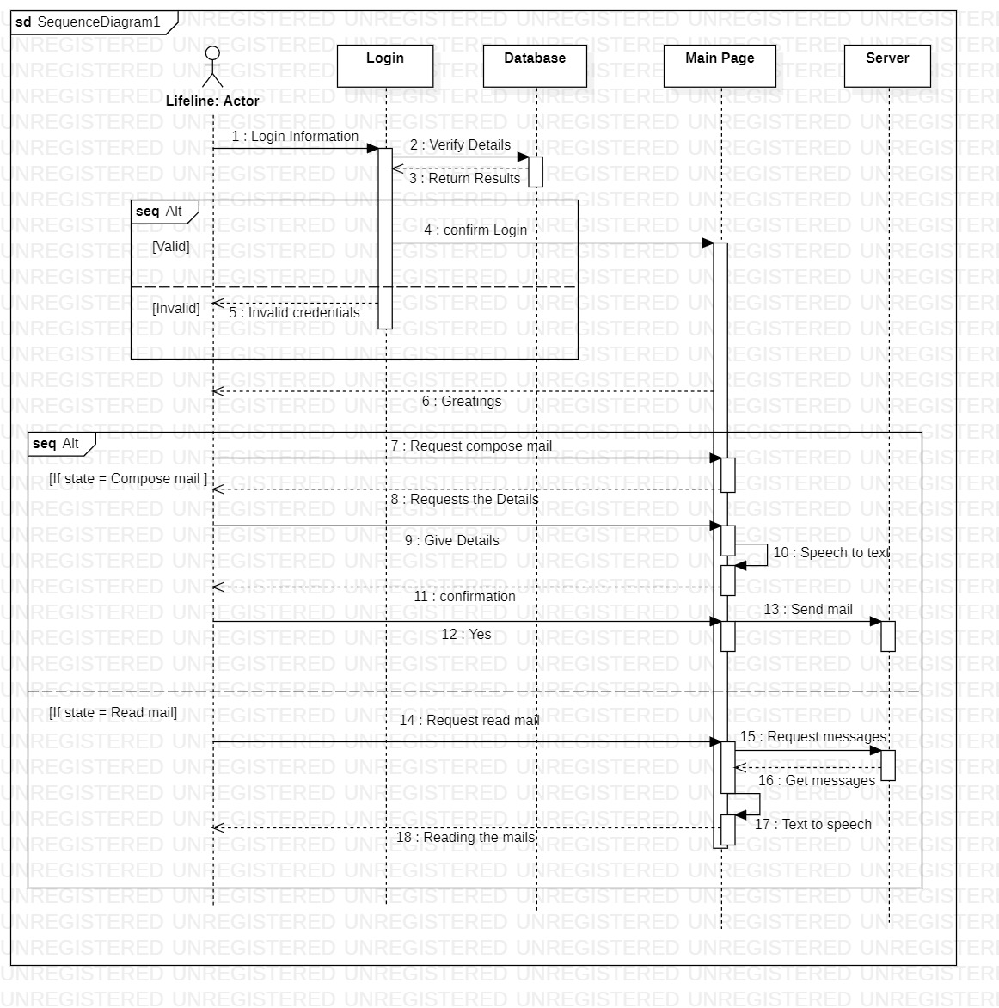
Sequence Diagram

Slide 18
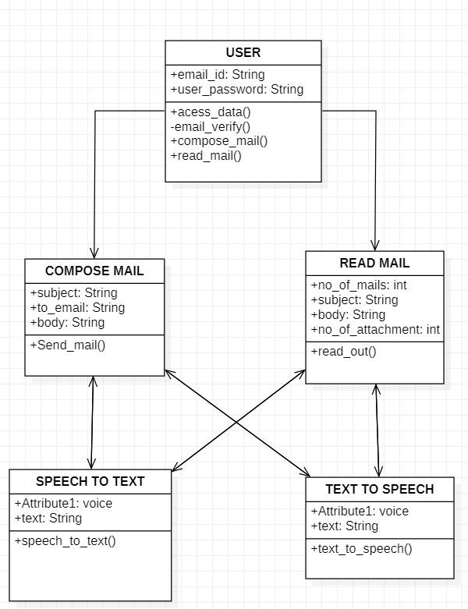
Class Diagram

Slide 19
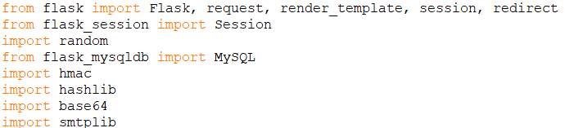
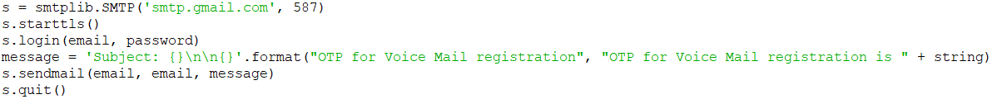
Implementation
Python Modules
Send Email

Slide 20

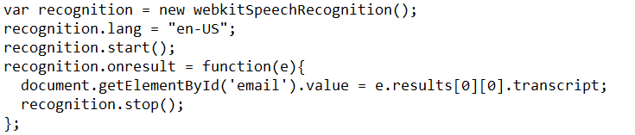
Text-to-speech
Speech-to-text

Slide 21
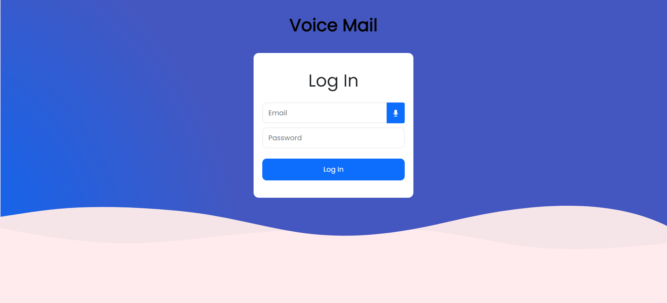

Log In Page

Slide 22
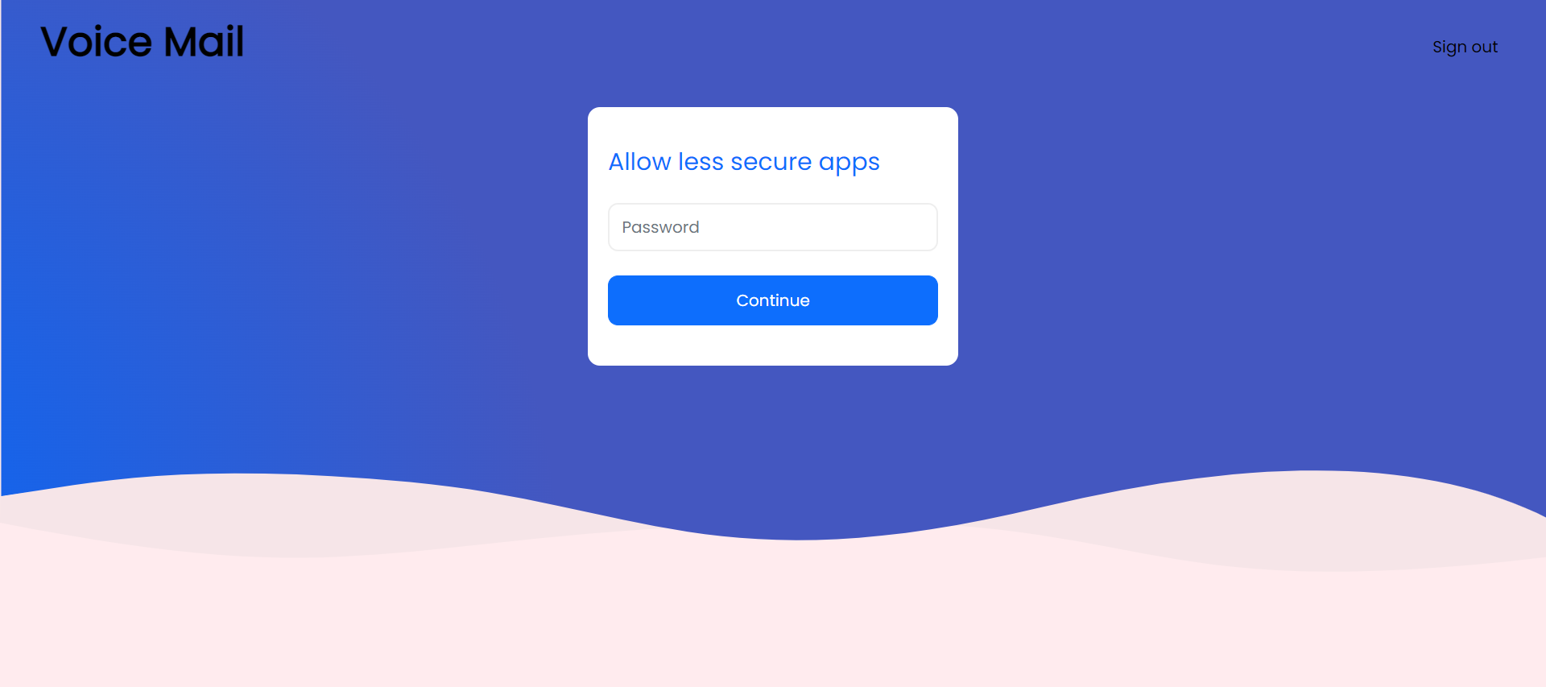
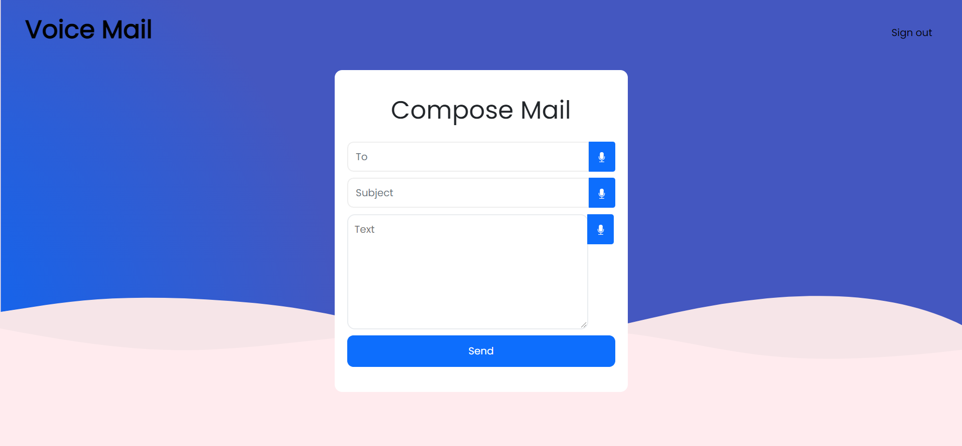
Log In page (Cont.)
Compose Mail Page

Slide 23
REFERENCES
https://flask.palletsprojects.com/en/2.0.x/
K. Jayachandran, P. Anbumani, “Voice Based Email for Blind People”, International Journal of Advance Research, Ideas and Innovations in Technology, ISSN: 2454-132X, Volume 3, Issue 3, 06 June, 2017
Pranjal Ingle, Harshada Kanade, Arti Lanke, “Voice based e-mail System for Blinds”, International Journal of Research Studies in Computer Science and Engineering (IJRSCSE) Volume 3, Issue 1, 2016, PP 25-30 ISSN 2349-4859
Saurabh Sawant, Amankumar Wani, Sangharsh Sagar, Rucha Vanjari, MR Dhage, “Speech Based E-mail System for Blind and Illiterate People”, International Research Journal of Engineering and Technology (IRJET), e- ISSN: 2395-0056, Volume: 05 Issue: 04, Apr-2018

Slide 24
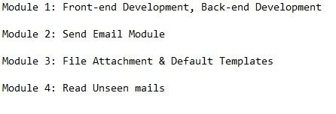
THANK YOU

